Slide 1
DATA SCIENCE
11 WEEK PART TIME COURSE
Week 10 - Artificial Neural Networks
Wednesday 25th May 2016

Slide 2
AGENDA
Tasks from Wednesday
Artificial Neural Networks
Lab
Review of last week

Slide 3
Task List
Check EC2 is Working
Read the following articles:
http://www.wired.com/2016/01/googles-go-victory-is-just-a-glimpse-of-how-powerful-ai-will-be/
http://www.wired.com/2014/01/geoffrey-hinton-deep-learning
https://sites.google.com/site/deepernn/home/blog/briefsummaryofthepaneldiscussionatdlworkshopicml2015
Install TensorFlow
DATA SCIENCE - Week 10 Day 2

Slide 4
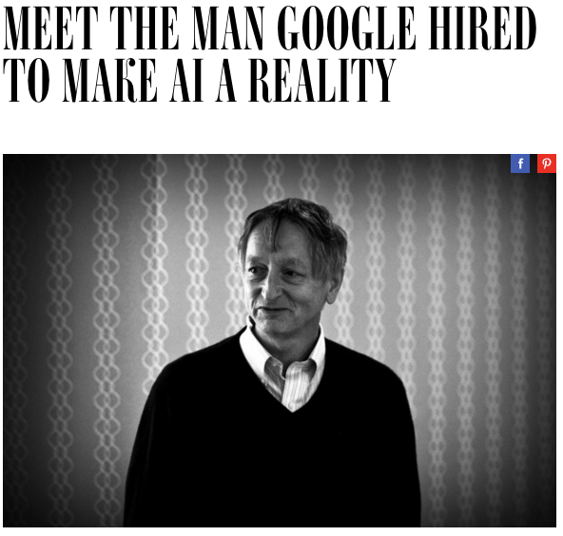
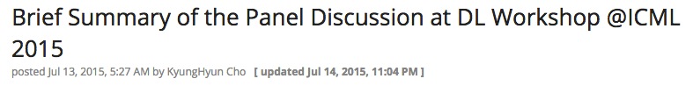
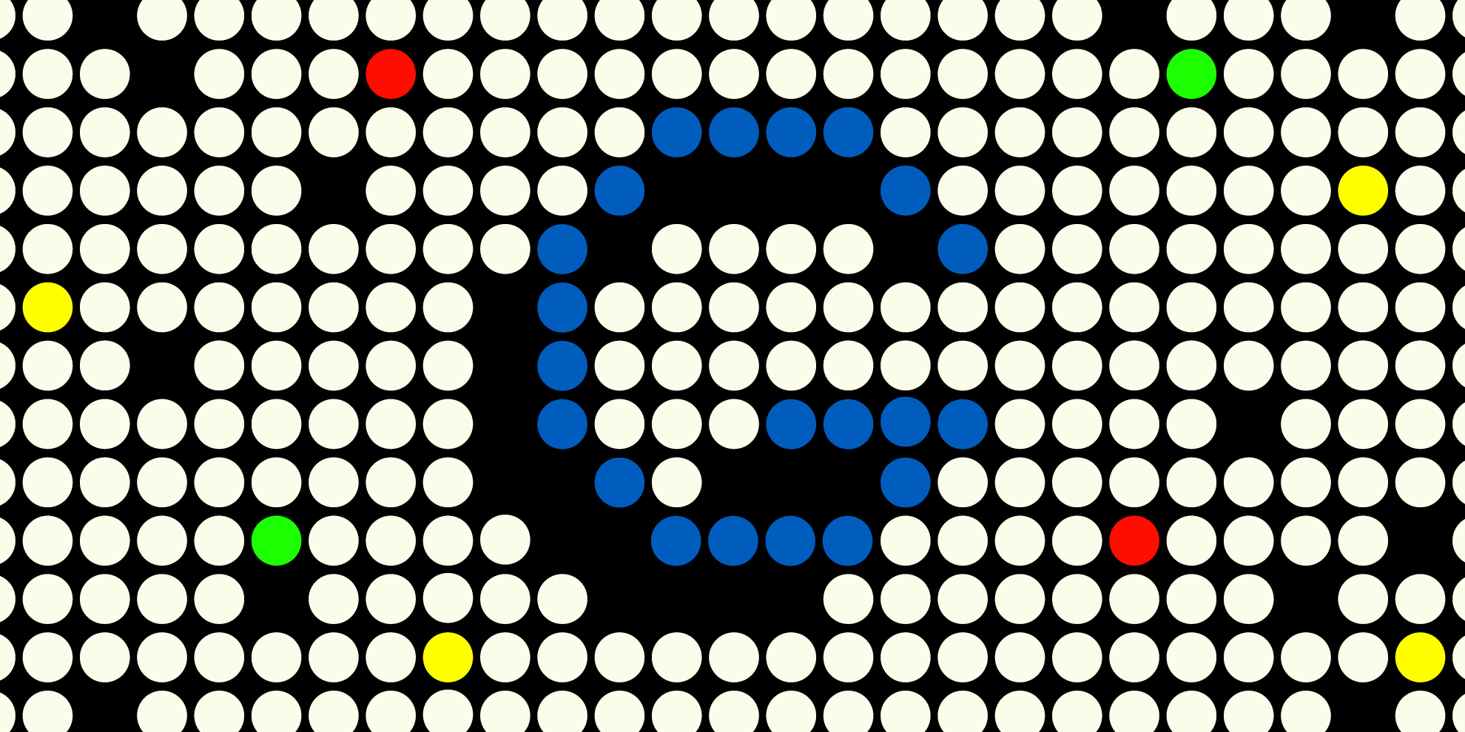
ARTICLES - DISCUSSION

Slide 5
WHAT IS A NEURAL NETWORK?
DATA SCIENCE PART TIME COURSE

Slide 6

WHAT IS A NEURAL NETWORK?

Slide 7
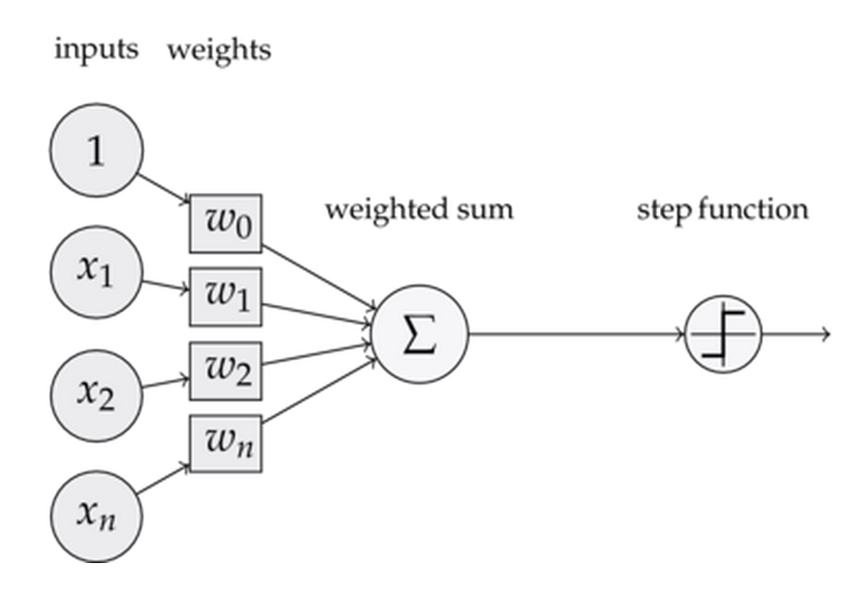
WHAT IS AN ARTIFICIAL NEURAL NETWORK?

Slide 8
WHAT IS AN ARTIFICIAL NEURAL NETWORK?
A computational system comprised of layers and each layer is built of interconnected perceptrons

Slide 9
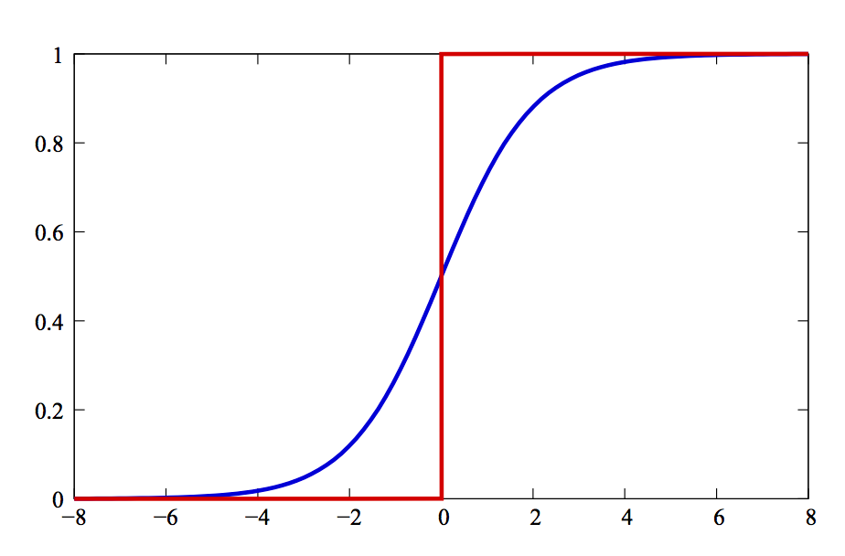
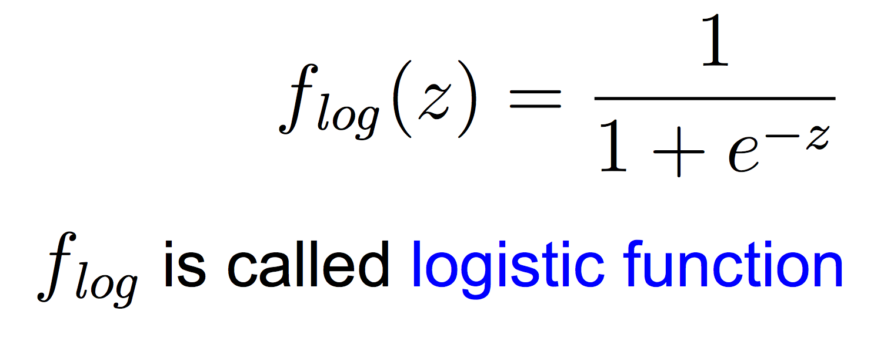
SINGLE PERCEPTRON
Takes in input and uses an activation function in order to output

Slide 10
SINGLE PERCEPTRON
Takes in input and uses an activation function in order to output
What is z?

Slide 11
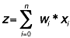
SINGLE PERCEPTRON
Takes in input and uses an activation function in order to output.
z is a weighted sum on the inputs.
Where wi is the weight on input xi

Slide 12
SINGLE PERCEPTRON

Slide 13
SINGLE PERCEPTRON
If f(z) if above a threshold, generally called theta, then the neuron “fires”

Slide 14
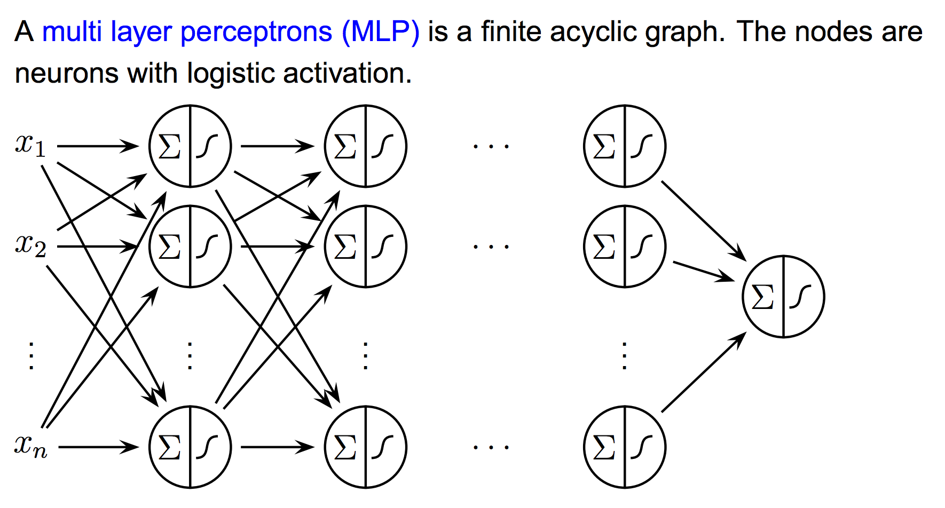
MULTI-LAYER PERCEPTRON
Output layer
Input layer
Several hidden layers

Slide 15
WHAT IS AN ARTIFICIAL NEURAL NETWORK?
Input Layer - the original features of our dataset (our X)
Hidden Layer - these are the derived features of the network. They are called hidden because they are not directly observed.
Output Layer - the final transformation of the inputs into a result

Slide 16
HOW DO WE FIND THE WEIGHTS?
DATA SCIENCE PART TIME COURSE

Slide 17
BACK-PROPAGATION
DATA SCIENCE PART TIME COURSE

Slide 18
BACK-PROPOGATION
As we train the model we update the sigmoid function weights in order to get the best predictions possible
If an observation goes through the model and is outputted as False when it should have been True the logistic functions in the single perceptrons are changed slightly.

Slide 19
BACK-PROPOGATION
Back-Propogation is a two-pass algorithm.
The Forward pass fixes the current weights and the predicted values are calculated.
The Backward pass calculates the errors on the output layer and are then back-propagated to give the errors at the hidden layer units.

Slide 20
BACK-PROPOGATION
Pros
Online model (updates as you go)
Very fast predictions
Can approximate almost any type of function
Can be used in a supervised and unsupervised manner
Very topical area of machine learning (lots of investment)
Getting easier to run
Cons
Requires many training samples to be considered good
Hard to describe what is happening
Requires a lot of hardware / computation power
(Can be) Slow to train

Slide 21
WHY ARE NEURAL NETWORKS IN THE NEWS?
DATA SCIENCE PART TIME COURSE

Slide 22
DEEP LEARNING
DATA SCIENCE PART TIME COURSE

Slide 23
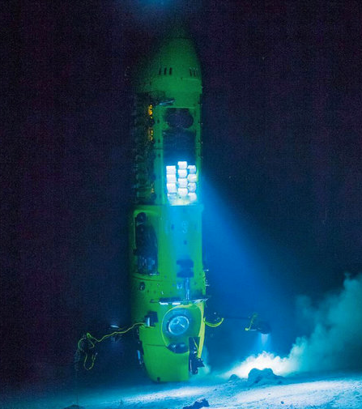
DEEP LEARNING
Traditional feedforward neural networks can be considered to have depth equal to the number of layers (i.e. the number of hidden layers plus 1, for the output layer)
Depth 2 is enough in many cases to represent any function with a given target accuracy. But this may come with a price: that the required number of nodes in the graph may grow very large

Slide 24
DEEP LEARNING - 2006 BREAKTHROUGHS
Three papers were published in 2006 that were breakthroughs for Deep Learning. They shared the following principles:
Unsupervised learning of representations is used to (pre-)train each layer
Unsupervised training of one layer at a time, on top of the previously trained ones. The representation learned at each level is the input for the next layer
Use supervised training to fine-tune all the layers (in addition to one or more additional layers that are dedicated to producing predictions)

Slide 25
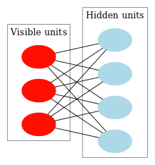
RESTRICTED BOLTZMANN MACHINES
The visible and hidden units may have a symmetric connection between them, and there are no connections between nodes within a group.
This allows for training to be efficient and takes less time to train.
Deep Belief Networks can be formed by stacking RBMs and then tuning the resulting network

Slide 26
AUTO-ENCODERS
The simplest form of an autoencoder is a feedforward neural net which is very similar to the multilayer perceptron (MLP), with an input layer, an output layer and one or more hidden layers connecting them.
The differences between autoencoders and MLPs, though, are that in an autoencoder, the output layer has the same number of nodes as the input layer. And instead of being trained to predict the target value Y given inputs X, autoencoders are trained to reconstruct their own inputs X. Therefore, autoencoders are unsupervised learning models.

Slide 27
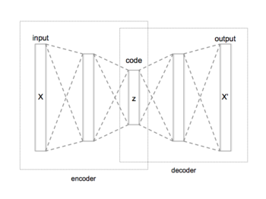
AUTO-ENCODERS

Slide 28
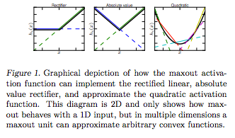
DROPOUT AND MAXOUT
Dropout reduces overfitting by randomly omitting half of the feature detectors on each training case.
A single maxout unit can be interpreted as making a piecewise linear approximation to an arbitrary convex function. Maxout networks learn not just the relationship between hidden units, but also the activation function of each hidden unit.

Slide 29
SCALING
Data Parallelism - parallelizes the training process by splitting the data set across processors (GPUs/CPUs). We use the same weights but different mini-batches in each processor. The gradients need to be synchronised after each pass.
Model Parallelism - this involves distributing the neurone across different processors. The output after each layer needs to be synchronised.

Slide 30
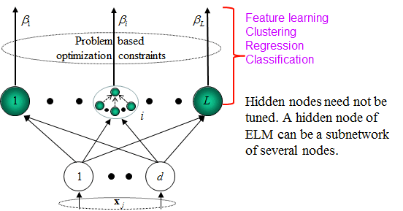
SHALLOW LEARNING - EXTREME LEARNING MACHINES

Slide 31
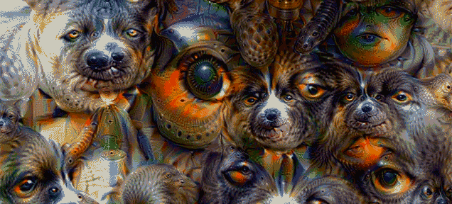
GOOGLE DEEP DREAM
http://deepdreamgenerator.com/

Slide 32
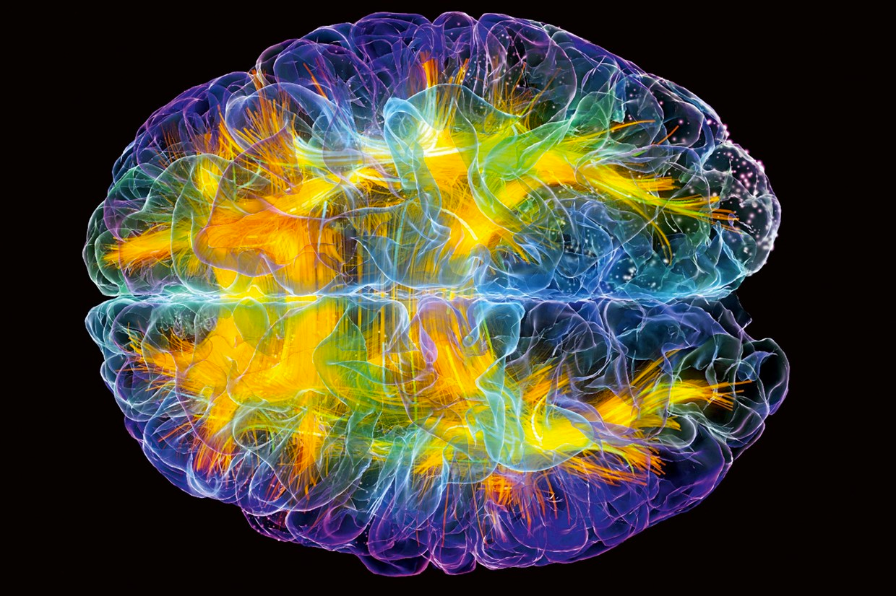
LAB
DATA SCIENCE PART TIME COURSE

Slide 33
DISCUSSION TIME
Questions
Review
Presentations
DATA SCIENCE - Week 10 Day 2

Slide 34
NATURAL LANGUAGE PROCESSING
COMMUNICATION SKILLS
DATA SCIENCE - Week 9 Review

Slide 35
PRESENTATIONS
10 mins presentation with 5 mins for questions
What did you do?
What were the results?
What did you achieve?
What did you learn?
What else will you try in the future?
Appendix with any interesting findings
On your own laptop or mine, your choice
DATA SCIENCE - Week 11 Day 1

Slide 36
PRESENTATIONS
Saturday 10 am - 3 pm @ General Assembly
Available to go over presentations
Send me the presentation on Friday evening if you want to come in on the Saturday
Give me a guide of what time you’ll be in
I’ll still be available over Slack if you can’t come in
DATA SCIENCE - Week 11 Day 1

